Slide 1
Disciplinary Research network presentation
By: Alfredo Any
ELECTRICAL ENGINEERING: Control and Robotics

Slide 2
agenda
Importance of electrical engineering
Current applications and issue
Major Organizations
Preeminent scholars
Seminal Works
Connection
Conclusion

Slide 3
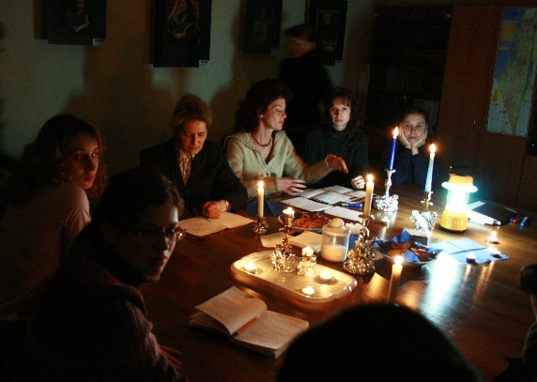
Is it important?
Unthinkable life without the use of electrical energy
Notes:
Our life would be unthinkable without the use of electrical energy. The growing utilisation of the latter is a decisive prerequisite for a rapid development of industry and agriculture.
A few examples will show the importance of electrical energy. Thus, electrical lighting is indispensable for working during the dark hours of the day. With increasing industrialisation, a growing proportion of electrical energy is used for the lighting of shops, offices, dwellings and for outdoor lighting. Man is relieved from heavy physical labour by the use of electrical devices. The drive of machines, hoisting gear and lifts is enabled in a simple form by the electromotor which in railway transport also has the advantage over internal combustion engines. There are many buildings where an air-conditioning system including heating, cooling and ventilation is installed for the operation of which electrical energy is required. At higher ambient temperatures, foodstuffs can only be kept for a prolonged period of time in refrigerators or cold-storage rooms which usually are also operated with electrical energy.
Without electrical energy, there would be no broadcasting and television systems, no telephone communication or telegraphy. In order to arrange automatic sequences of operation in production, devices of control an regulation engineering are required which, today, are driven almost exclusively by electrical energy. Table 1.1. shows a survey of the two large fields of electrical engineering, power electrical engineering and information electrical engineering.
The consumption of electrical energy by the various branches of economy is quite different. The chemical industry and metallurgy have a particularly high consumption. For the production of the electrical conductor materials electrolytic copper and aluminium, very large amounts of electrical energy are required.

Slide 4
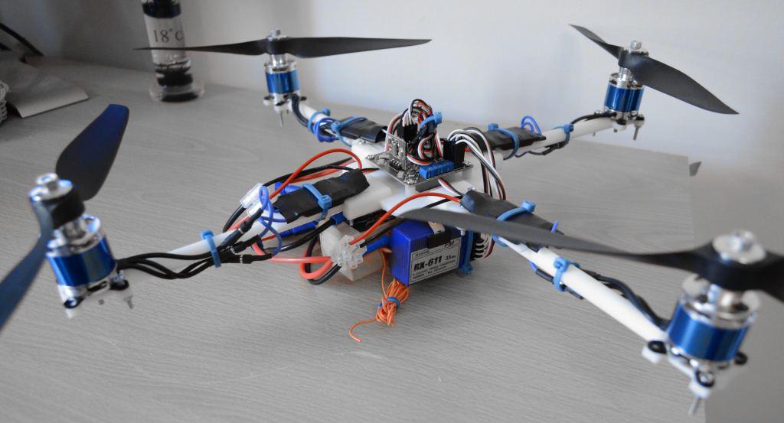
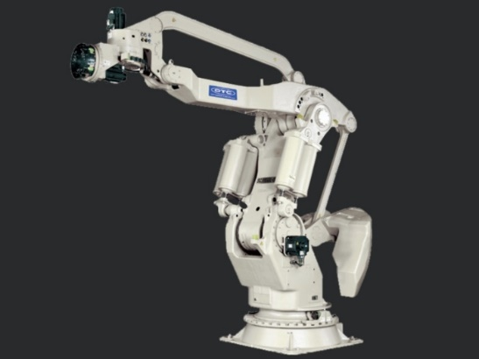
Current applications
Fuzzy Control
Robot Manipulators
Mobile Robots

Slide 5
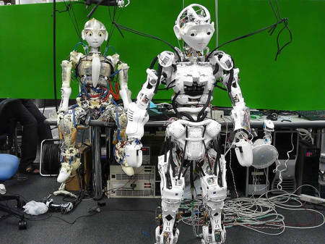
Current applications
Biologically-Inspired Robots:
Animal-like Robots
Humanoid Robots

Slide 6
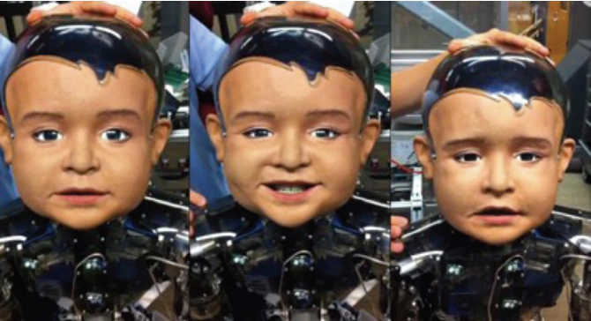
Current Issue
The edge of science and technology:
To realize the invention of humanoid robots

Slide 7
Major organizations
IEEE (Institute of Electrical and Electronics Engineers)➔
IET (Institute of Engineering and Technology) ➔
IEE (Institution of Electrical Engineers) ➔
NSPE (National Society of Professional Engineers) ➔
Notes:
IEEE: New York City, 1400 conferences, 186 journals, focuses on electrical engineering and other technologies (biotech, telecom, power)
IET: London, 1200 meetings, 82 journals, related to IEE (they were one)
IEE: Luxembourg, 1900 people, operates in several countries (Lux, Germany, Slovakia, US, China, Japan, S Korea), 27 conf, 21 journal titles
NSPE: New York City, addressing professional concerns if licensed Professional Engineers in all disciplines; professional issues (licensing, ethics, employment, legislative and regulatory issues, education)

Slide 8
Preeminent scholars/Seminal works
Greg Bear
Focusing on science fiction and fantasy
G. Bear. (2007, Nov.). “Is artificial life moving any closer?” Nature. [On-line]. 450. Available: http://www.nature.com/nature/journal/v450/n7170/full/450612a.html [Oct. 20, 2014].
Nebula Awards and Hugo Awards
Notes:
Is artificial life moving any closer?
Seminal work
Robots exist among us

Slide 9
Preeminent scholars/Seminal works
Bojan Jakimovski
IT Analyst
B. Jakimovski. Biologically Inspired Approaches for Locomotion, Anomaly Detection and Reconfiguration for Walking Robots. Berlin, Germany: Springer Verlag, 2011.
University Stuttgart, Germany
Notes:
Cited 60 times
Seminal work
Locomotion → robots movement

Slide 10
Preeminent scholars/Seminal works
Jaron Lanier
IEEE Virtual Reality Career Award in 2009
J. Lanier. (2010, Aug.). “The first church of robotics (artificial intelligence).” The New York Times. [On-line]. Available: http://www.nytimes.com/2010/08/09/opinion/09lanier.html?pagewanted=all [Oct. 20, 2014].
Worked in Atari
Notes:
The first church of robotics
500 times cited
Development of robotics

Slide 11
connection
History of Robotics
E. Gracia, M. A. Jimenez, P. B. de Santos, and M. Armada. “The evolution of robotics research.” IEEE Robotics & Automation Magazine, 1070-9932, pp. 90-103, 2007.
Major Organization:
IEEE
Preeminent scholar:
Greg Bear
Notes:
Greg bear: discussing about robots are existing among us, moving closer to our lives

Slide 12
connection
Functionalities of Biologically-Inspired Robots
X. Zhang and H. Zheng. “Walking up and down hill with a biologically-inspired postural reflex in a quadrupedal robot.” Auton Robot, vol. 25, pp. 15-24, 2008.
M. Kawato. “Brain controlled robots.” HFSP Journal, vol.2, pp. 136-142, June 2008.
N. Sommer and A. Billard. “Face classification using touch with a humanoid robot hand.” 2012 12th IEEE-RAS International Conference on Humanoid Robots, pp. 120-125, Dec. 2012.
IEEE
Bojan Jakimovski
Greg Bear
Jaron Lanier
IEEE
Jaron Lanier
Notes:
A ➔ Robots moving up and down (locomotion)
B ➔ Robots can be controlled as a human, robots are useful as the second body parts for certain people (with disabilities)
C ➔ Robots can do things like human such as recognizing face using hands

Slide 13
connection
Anatomy of Humanoid Robots
R. Tomovic and G. Boni. “An adaptive artificial hand.” IRE Transactions on Automatic Control, pp. 3-10, 1962.
Y. Nakanishi, Y. Asano, T. Kozuki, H. Mizoguchi, Y. Motegi, M. Osada, T. Shirai, J. Urata, K. Okada, and M. Inaba. “Design concept of detail musculoskeletal humanoid ‘Kenshiro’ – toward a real human body musculoskeletal simulator.” 2012 12th IEEE-RAS International Conference on Humanoid Robots, pp. 1-6, 2012.
Greg Bear
Jaron Lanier
IEEE
Greg Bear
Notes:
A ➔ discussing about the creation of hand of humanoid robots existing among us, development of it, effects toward the future.
B ➔artificial chest is moving closer to be existed.

Slide 14
connection
Impacts of the Existence of Robots
K. Wada and T. Shibata. “Social and physiological influences of living with seal robots in an elderly care house for two months.” Robot and Human Interactive Communication, 2007. RO-MAN 2007. The 16th IEEE International Symposium on, pp. 107-112, 2007.
E. Park, S. S. Kwak, K. J. Kim, and A. P. del Pobil. “Robot as teammate vs. opponent in video gaming.” 2011 11th IEEE-RAS International Conference on Humanoid Robots, pp. 47-52, Oct. 2011.
IEEE
Greg Bear
IEEE
Greg Bear
Notes:
A ➔ robots are useful for humans related to the artificial life existing among us as helpers
B ➔ robots are existing but giving negative impacts toward humans, as artificial life are existing to endanger us or making us disadvantageous.

Slide 15
Conclusion
Major Organizations
The most renowned and influential organization
IEEE
Control and Robotics
Further Research for Reaching the Goal of Inventing the Better Humanoid Robots!
Preeminent Scholars
Journal Articles
Notes:
IEEE → most renowned organization
Control and robotics → published by many organizations, related to the seminal works written by preeminent scholars, and discussed in many journal articles.
Need further research in certain aspects, for the better future.

Slide 16
THANK YOU!!!
ANY QUESTIONS?

